Slide 1

Comparing
Technical Indicators
BOLLINGER BAND
By Sarah

Slide 2

Objective
The objective of this presentation is to evaluate and compare the performance of two trading strategies that combine popular indicators with the Bollinger Band.
Specifically, we will examine the effectiveness of combining the Exponential Moving Average (EMA) with bollinger band and the Moving Average Convergence Divergence (MACD) with bollinger band.
The aim is to determine which strategy demonstrates superior performance in identifying potential trend reversals, generating accurate trading signals, and maximizing profit potential.
By analyzing historical data and key performance metrics, we seek to provide insights into the effectiveness of these combined strategies and their potential value in enhancing trading decisions.

Slide 3
Let's begin by discussing the strategy that combines the Exponential Moving Average (EMA) with the Relative Strength Index (RSI).
EMA: The EMA is a trend-following indicator that provides a smoothed line representing the average price over a selected time period. By combining the EMA with RSI, we can benefit from the EMA's ability to identify trends while leveraging the RSI's overbought and oversold conditions as potential reversal points.
Bollinger Band:The Bollinger Bands is a popular technical analysis tool that consists of a moving average and two bands that represent price volatility. It helps identify potential price reversals, overbought and oversold conditions, and the width of price fluctuations in financial markets
We will analyze historical price data and evaluate the success rate, average profitability, and risk-to-reward ratio of this combined strategy to determine its effectiveness.
Overview of the EMA and Bollinger band Combination Strategy

Slide 4

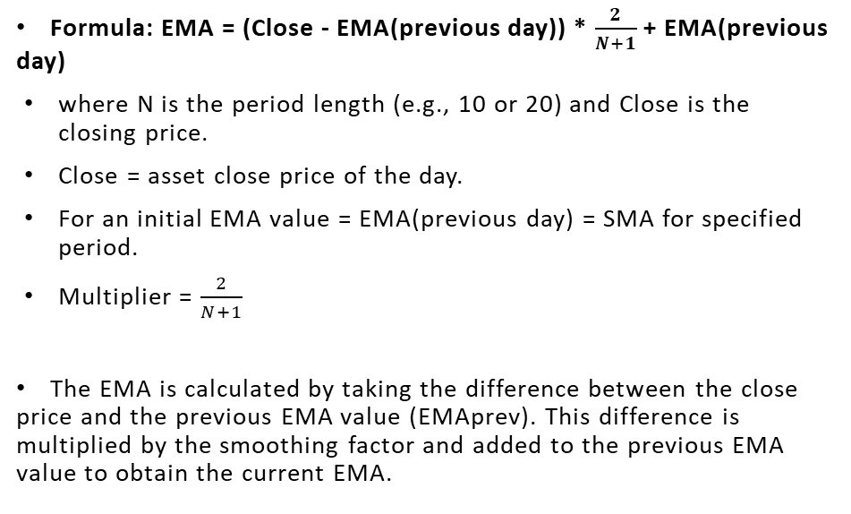
EMA formula

Slide 5
Bollinger Band Formula
BOLU = MA(TP,n) + m*𝝈[TP,n]
BOLD = MA(TP,n) - m*𝝈[TP,n]
Where:
BOLU = Upper Bollinger Band
BOLD = Lower Bollinger Band
MA=Moving average
TP(typical price)=(High + Low + Close) / 3
n = Number of days in smoothing period (typically 20)
m = Number of standard deviations (typically 2)
𝝈[TP,n] = Standard deviations over last n periods of TP

Slide 6




Defining Entry and Exit Condition
Buy Entry: When the 10 period EMA is > 20 period EMA
Exit: The current close < bollinger middleband.
Sell Entry: When the 10 period EMA is < 20 period EMA
Exit: The current close > bollinger middleband.

Slide 7
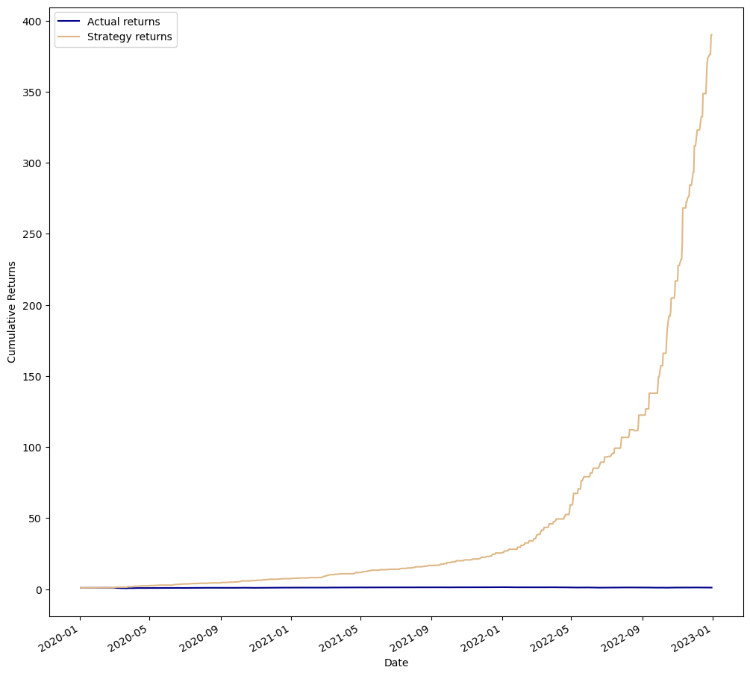
Backtest Result

Slide 8
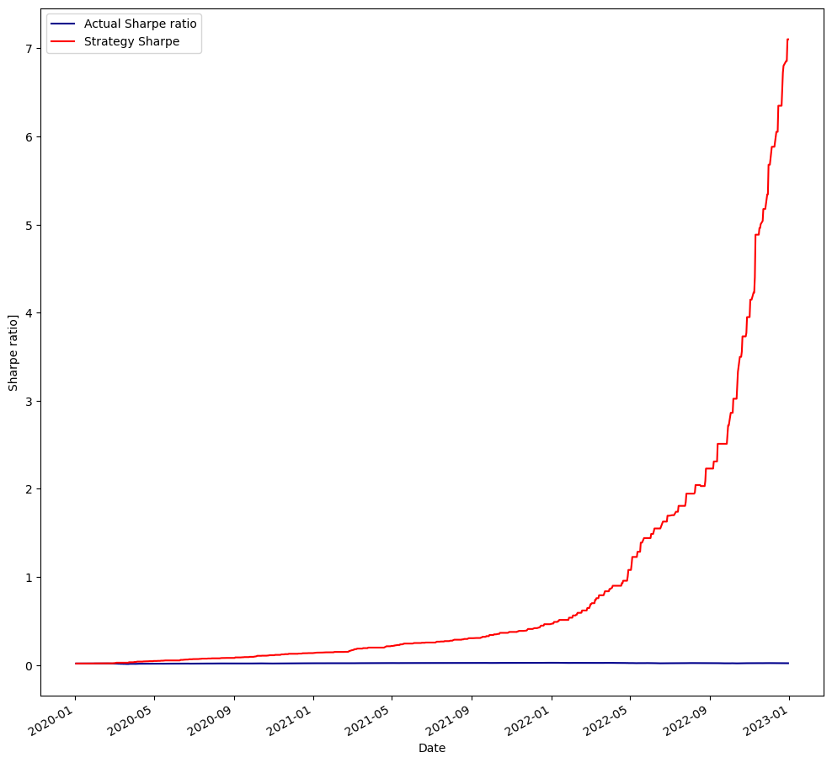
Sharpe Ratio Result

Slide 9
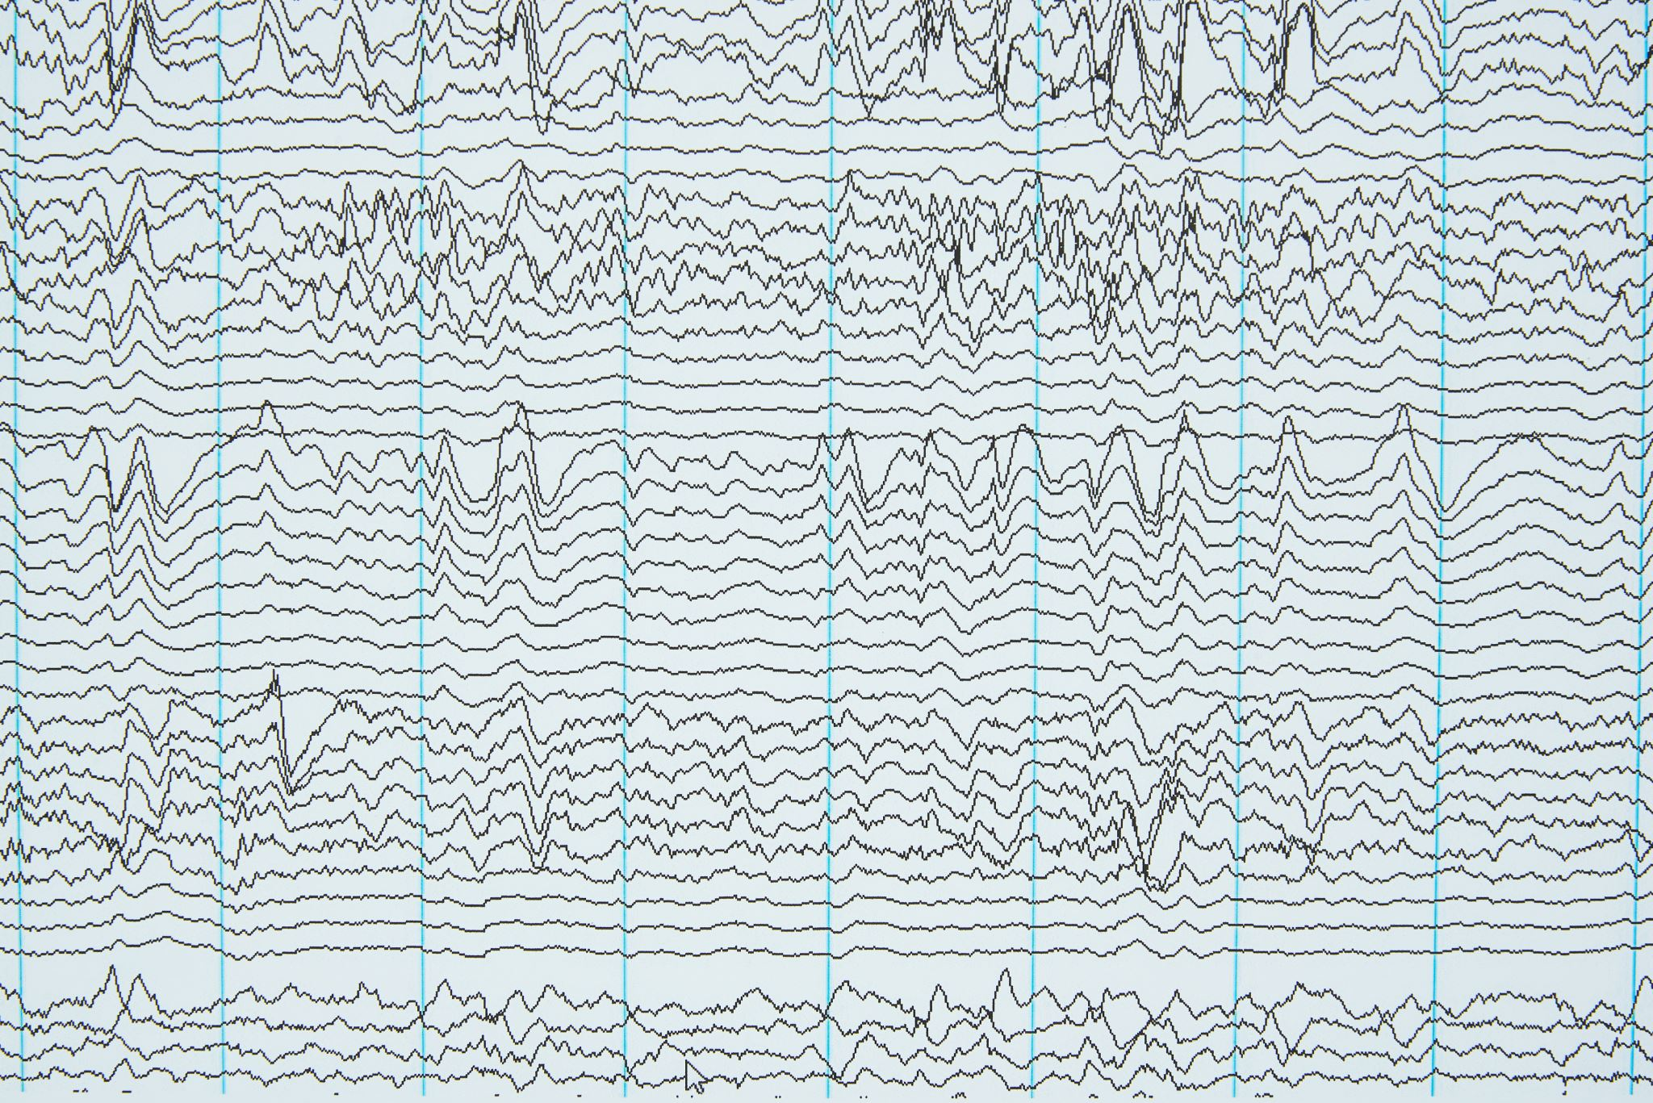
MACD Formula
Moving Average Convergence Divergence (MACD): MACD is a versatile indicator that combines trend-following and momentum characteristics. It consists of two lines: the MACD line, which represents the difference between two moving averages, and the signal line, which is a moving average of the MACD line. The MACD line crossing above or below the signal line is often considered a potential reversal signal.
It is calculated as follows:
MACD=12-Period EMA − 26-Period EMA
Signal line = 9- period EMA of MACD Line
Histogram = MACD line - Signal line

Slide 10
Defining Entry and Exit Condition for MACD & BB
Buy Entry: MACD line > Signal line.
Exit: The current close < bollinger middleband.
Sell Entry: MACD line < Signal line
Exit: The current close > bollinger middleband.

Slide 11

Backtest Result

Slide 12
Sharpe Ratio Result

Slide 13
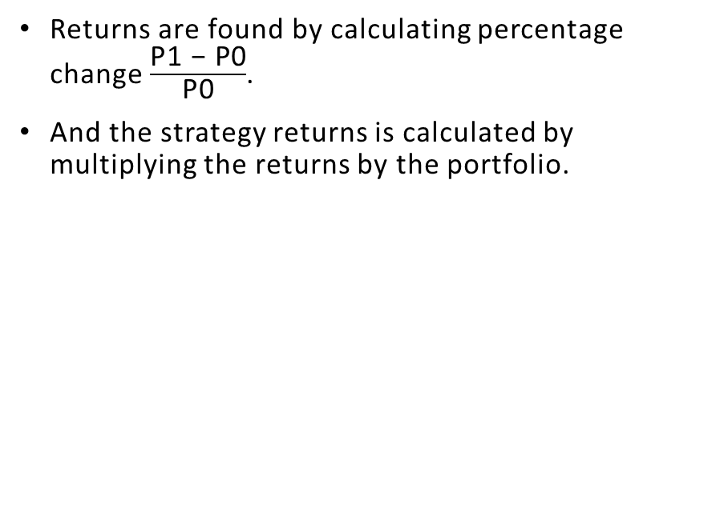
Returns Formula

Slide 14
Based on the analysis conducted, it has been found that both the MACD and Bollinger Bands strategy and the EMA and Bollinger Bands strategy demonstrated exceptional performance, generating returns of 400 times the initial investment.
These findings suggest that both strategies were highly effective in identifying potential trend reversals and utilizing the Bollinger Bands' middle band as an exit strategy.
These findings highlight the effectiveness of incorporating the Bollinger Bands into trading strategies alongside either the MACD or EMA indicators.
Traders can utilize the Bollinger Bands to confirm potential trend reversals, determine entry and exit points, and manage risk more efficiently.
Findings

Slide 15
It is important to note that while both strategies produced remarkable returns, individual preferences, risk tolerance, and market conditions should be considered when selecting a trading strategy.
In summary, based on the analysis conducted, both the MACD and Bollinger Bands strategy and the EMA and Bollinger Bands strategy demonstrated exceptional performance, producing returns of 400 times the initial investment.
By incorporating the Bollinger Bands into their trading strategies alongside the MACD or EMA indicators, traders can potentially achieve significant profitability and enhance their decision-making processes in dynamic financial markets.
Conclusion

